Slide 1


Customer Segmentation and Recommendations
Using Age and Reviews
Gourav Verma
DSC-550 : Machine Learning
Summer-2020
Prof. Brant Abeln
Bellevue University, NE

Slide 2
content
Data
Customer Segmentation
Uses cases and AFINN sentiment analysis
K-mean Clustering
Outcome
Recommendation
Cross validations
Train and Predict

Slide 3

Problem statement
Understanding customer sentiments is of paramount importance in marketing strategies today. Not only will it give companies an insight as to how customers perceive their products and/or services, but it will also give them an idea on how to improve their offers.

Slide 4
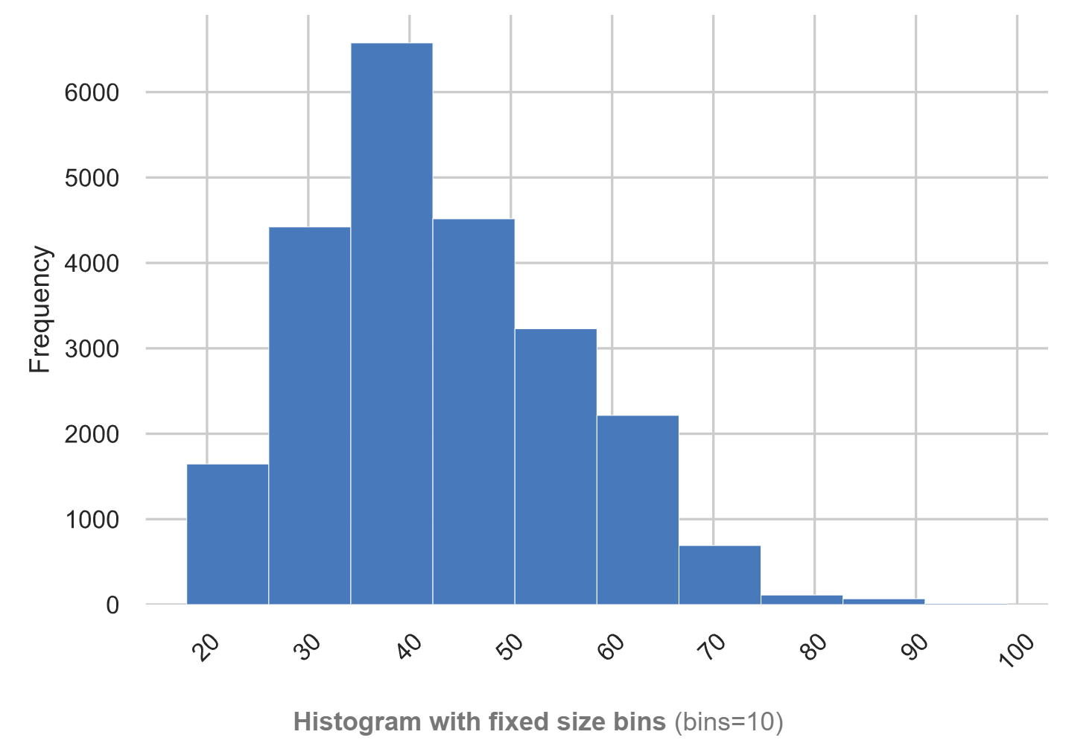
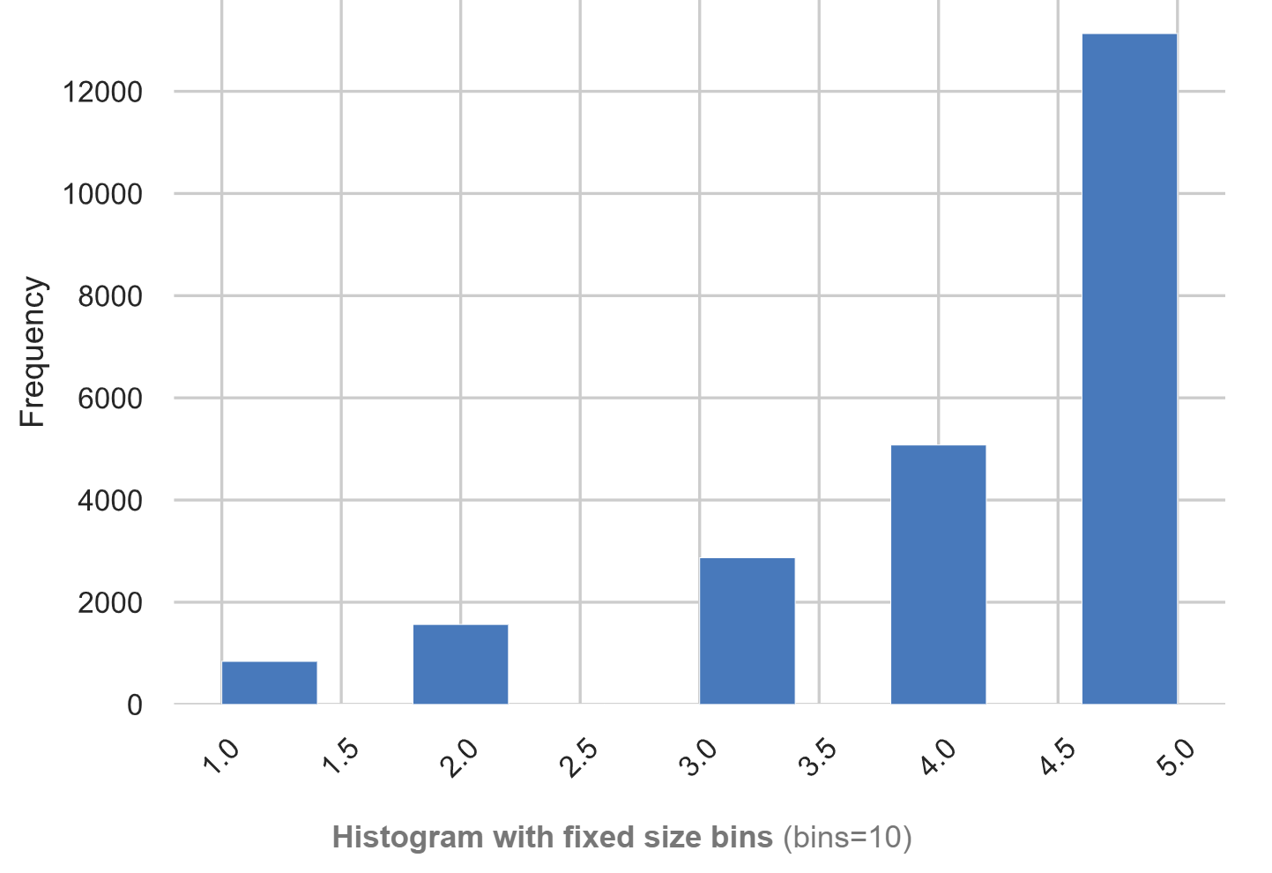
data
Source: https://www.kaggle.com/nicapotato/womens-ecommerce-clothing-reviews
23486 rows
10 feature variables
Each row for a customer review
Clothing ID: Unique for each piece of cloth
Age: Range from 18-99
Review Text: String variable for the review
Rating: 1 Worst, to 5 Best

Slide 5
Customer Segmentation
Use Cases:
Target individuals to improve their service.
Track customer sentiment over time.
Determine if a particular customer segment feel more strongly about your product.
Track how a change in product or service affects how customers feel.
AFINN lexicon:
Wordlist-based approach for sentiment analysis.
Words score range from -5 to +5
Library contains over 3,300+ words

Slide 6
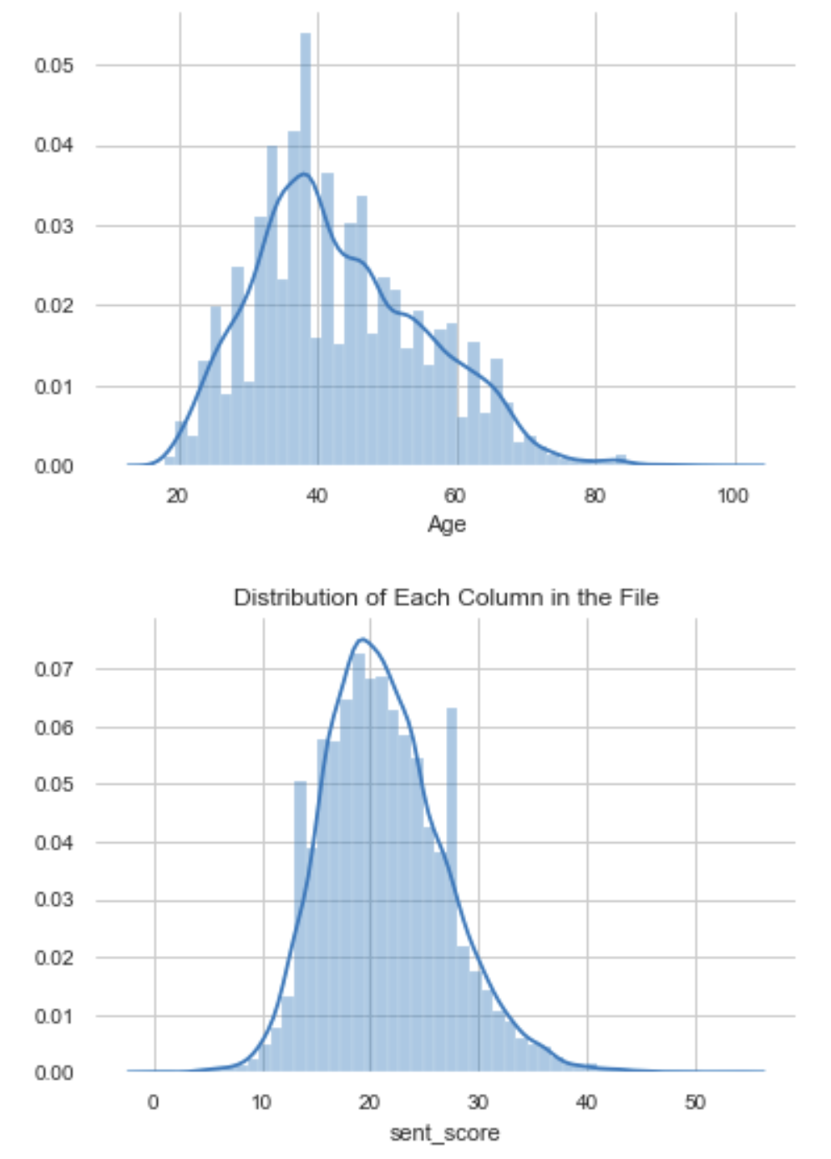
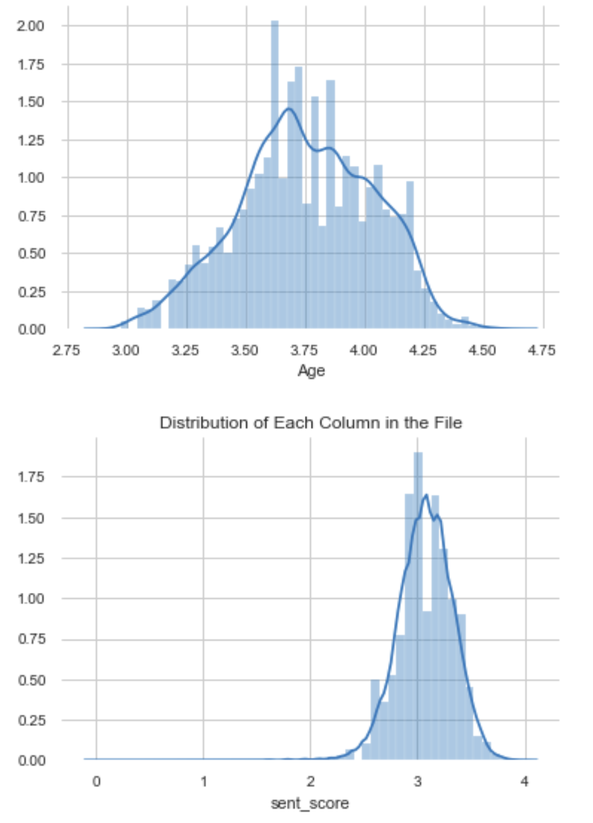
Data preparation
Drop null values.
Generate user sentiment score for each review text using AFINN.
+ve score means positive sentiment, -ve score means negative sentiment.
Added highest negative score to each score, for having distribution on +ve side.
Normalization using Log of sentiment score and age.
Log
Skewed
Normal

Slide 7
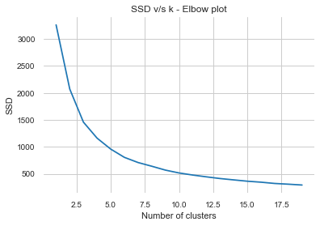
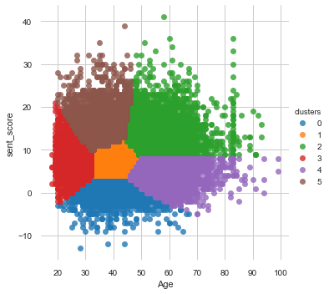
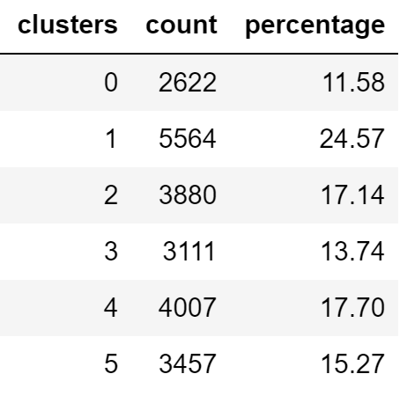
K-mean clustering
6

Slide 8
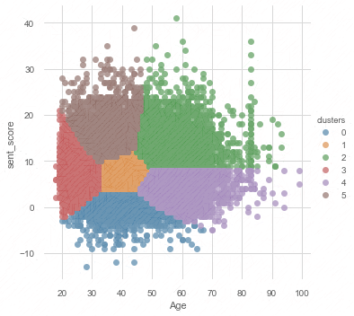
outcome
0 - Middle Aged customers with Negative reviews
1 - Middle Aged customers with Fairly Positive reviews
2 - Older customers with Positive reviews
3 - Young customers with Fairly Positive reviews
4 - Older customers with Fairly Positive reviews
5 - Fairly young customers with Positive reviews
The ranters (unhappy customers) ==> Cluster 0
The ‘on the fence’ bunch ==> Cluster 1, 3 & 4
The ravers (happy customers) ==> Cluster 2, 5

Slide 9
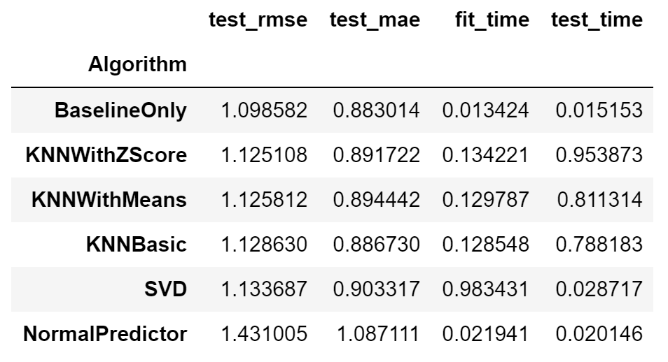
Recommendation
Collaborative filtering approach using Surprise package
Predicts unknown ratings by using the similarities between users.
Train-Test split with 25% testing.
Cross validation for different recommender algorithms.
MAE – Measure of the average magnitude of the errors in a set of predictions, without considering their direction.
RMSE - Quadratic scoring rule that also measures the average magnitude of the error.

Slide 10
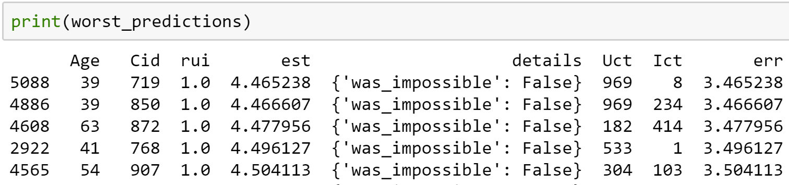
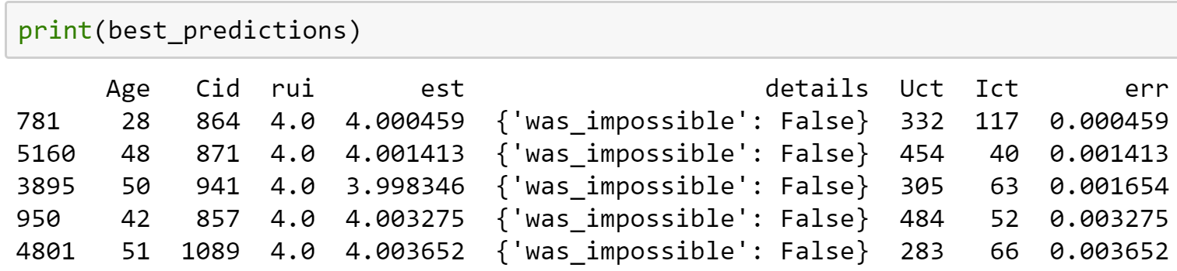
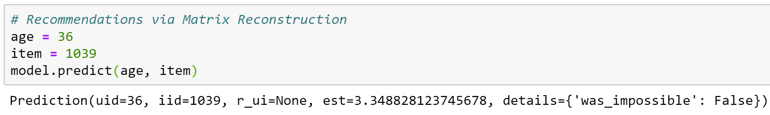
Train and Predict
BaselineOnly algorithm has the lowest MAE and RMASE values.
Build model, fit and test using test-train split.

Slide 11
Thank you..

